Slide 1



Simple and Effective Methods for Managing and Sharing Scientific Data
Amber Spackman Jones
Jeffery S. Horsburgh
Notes:
I’m borrowing a number of slides from Jeff Horsburgh, who is a professor of Civil and environmental Engineering. He regularly gives a presentation as part of the Research Scholars Forum, so you may have seen this or you may in the future, but it is material that bears repeating.

Slide 2
Data Management 101
Simple guidelines to improve data management
Benefits
Improved data organization – facilitates analysis
Improved reproducibility
Improved capacity for data re-use
Facilitates compliance with funding sources and publishers
Borer, E.T., E.W. Seabloom, M.B. Jones, and M. Schildhauer (2009). Some simple guidelines for effective data management, ESA Bulletin, 90(2):205-214, http://dx.doi.org/10.1890/0012-9623-90.2.205

Slide 3
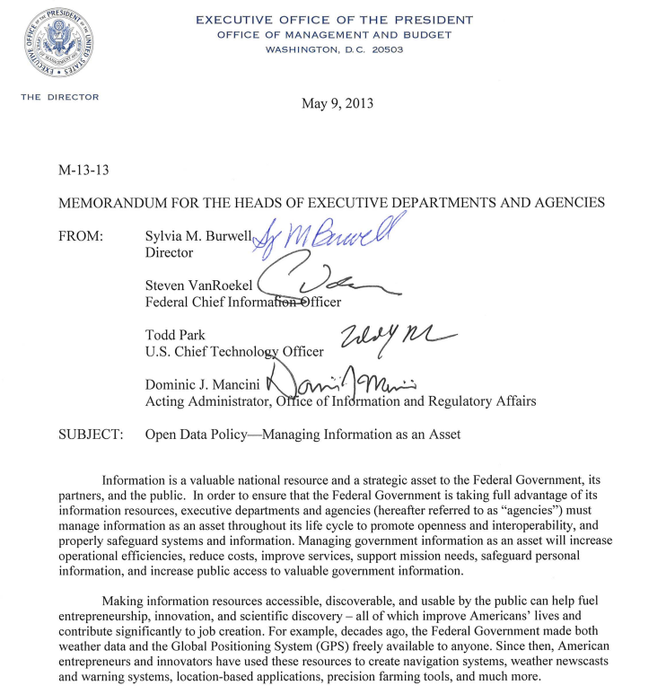
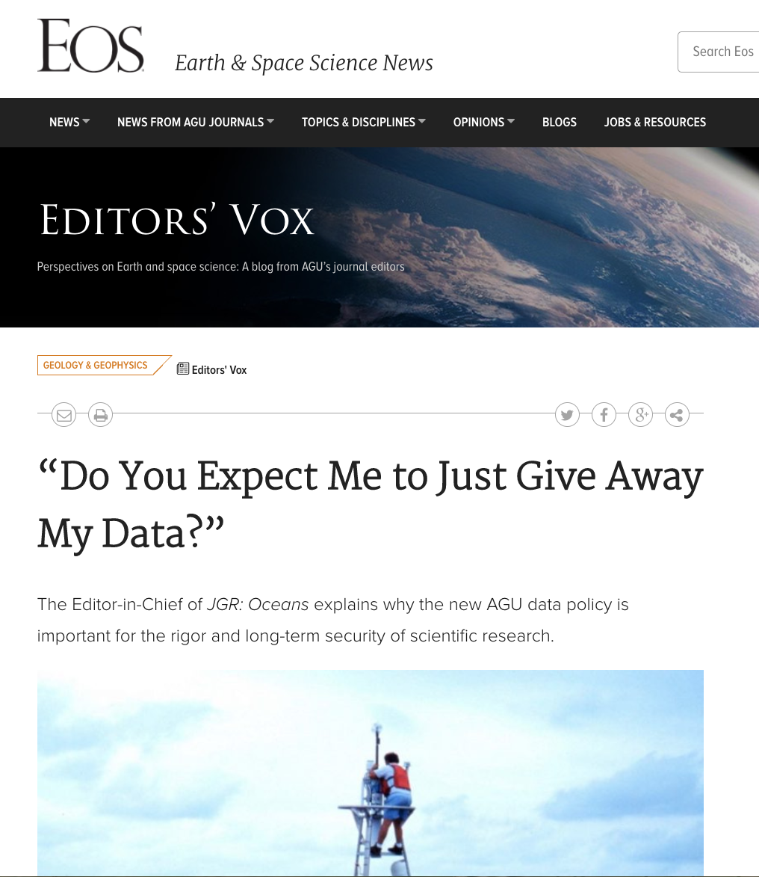
Data Sharing Requirements
Federal grants require data sharing and availability (data management plans)
Many scholarly journals (all AGU journals)
Data is defined broadly (per AGU policy):
Data used to generate, or be displayed in, figures, graphs, plots, videos, animations, or tables in a paper.
New protocols or methods used to generate the data in a paper.
New code/computer software used to generate results or analyses reported in the paper.
Derived data products reported or described in a paper.
“When you publish a research paper, you are also simultaneously publishing the data that supports your work. The readers of your article have equal rights to see both the words and the numbers – they are inseparable.”
“Data available by contacting the author.”
Notes:
Add slide on federal definitions

Slide 4
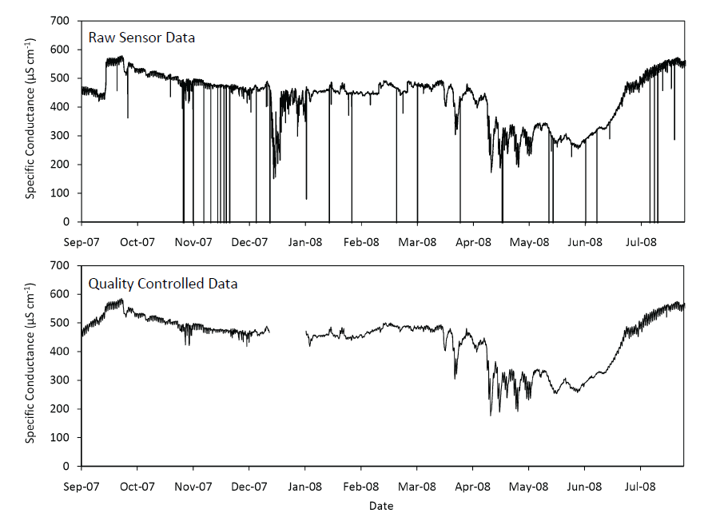
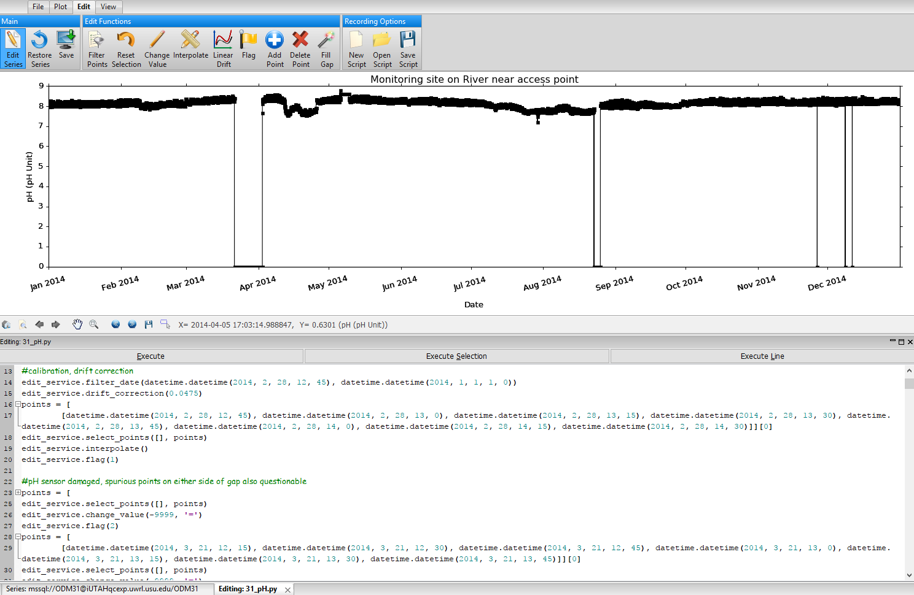
1. Don’t Mess with the Raw Data
Always store uncorrected data with all of its “bumps and warts”
You could change something that was actually correct
You could make mistakes while correcting other mistakes
Script procedures and write results to a new file/copy of the data
Notes:
Add ODM Tools Screenshot

Slide 5
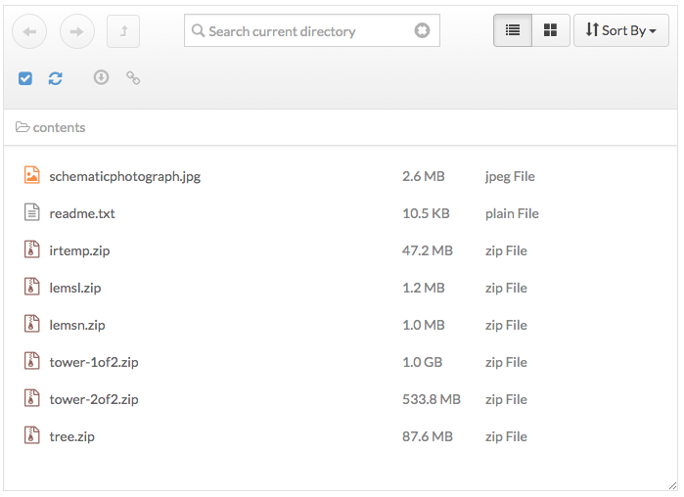
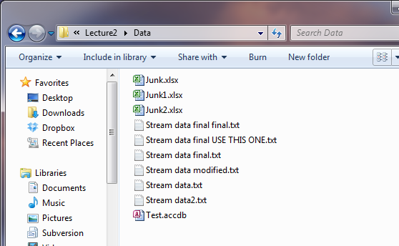
2. Use Descriptive File Names
Use only plain ASCII characters and avoid spaces
Brief, but descriptive of content
Include a “readme” file when using many files in a directory

Slide 6
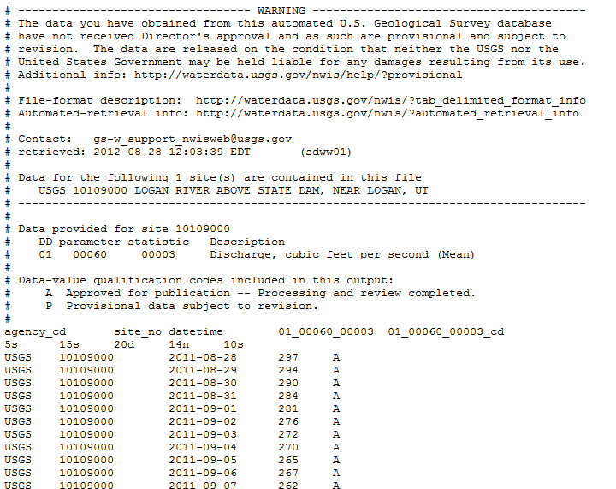
3. Use Descriptive Headers in Files/Tables
Standard convention for many software applications
Encapsulate data and descriptive metadata together
Notes:
Work on this slide

Slide 7
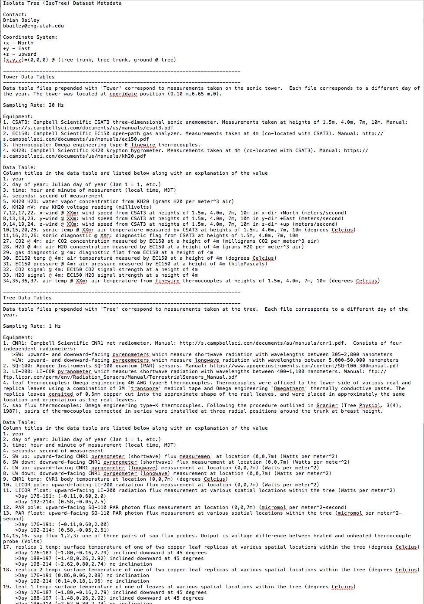
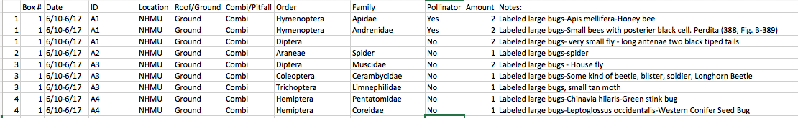
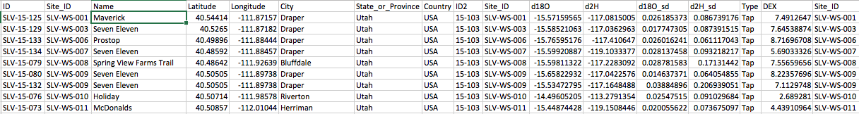
3. Use Descriptive Headers in Files/Tables
Standard convention for many software applications
Encapsulate data and descriptive metadata together
Notes:
Work on this slide

Slide 8
4. Archive Data in Non-Proprietary Formats
Microsoft Excel is widely available and used now, but what about in 10 years? 20 years?
How many other software programs can open your data?
Will your data disappear if the file format/software become obsolete?

Slide 9
What format to use?
Store it in a file format that can be used by many different software programs
Text files – e.g., comma separated values (CSV) for tabular data
Use a standard file format accepted by your scientific community
Consider both format and syntax (e.g., the structure within the file)

Slide 10
For Tabular Data
Each row should have a single observation
Each column should represent a single variable
Every cell should have a single value
There should be only one column for each type of information
Do not mix data types within a column
Use standard formats within cells
Be consistent
Avoid special characters
Avoid using your column delimiter in the data
Use standard date formats (e.g., YYYY-MM-DD)
Use null and NoData values correctly to represent empty or missing data values
Do not repeat metadata- set up separate table
White, E.P, Baldridge, E., Brym, Z.T., Locey, K.J., McGlinn, D.J., and S.R. Supp (2013). Nine simple ways to make it easier to (re)use your data, PeerJ PrePrints, http://dx.doi.org/10.7287/peerj.preprints.7v2

Slide 11
5. Consider Data Entry
All data collection involves some data entry
Recording observations and notes in a field notebook
Transcribing field notebooks and sheets into digital forms
Automated processing of sensor data streams into a database
When you create data entry tools:
Use pre-designed forms or templates (electronic or paper)
Use lists of valid values rather than free form text entry
Use validation checks (e.g., range checks)
Example: pH must be between 0 and 14. If it’s not – there is a problem!

Slide 12
6. Automate Analyses
Code creates reproducible results
Code is a record of the steps involved in processing and analyzing data
Code can be shared
Code can be re-executed at any time

Slide 13
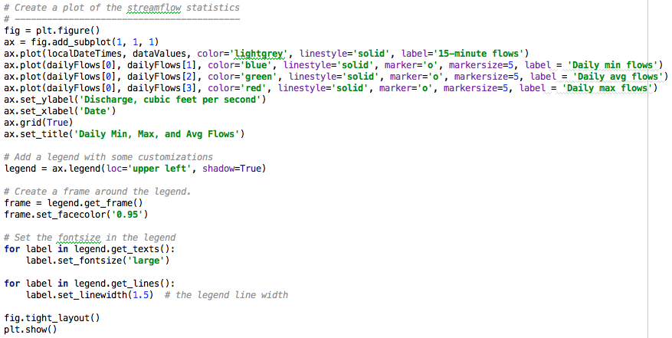
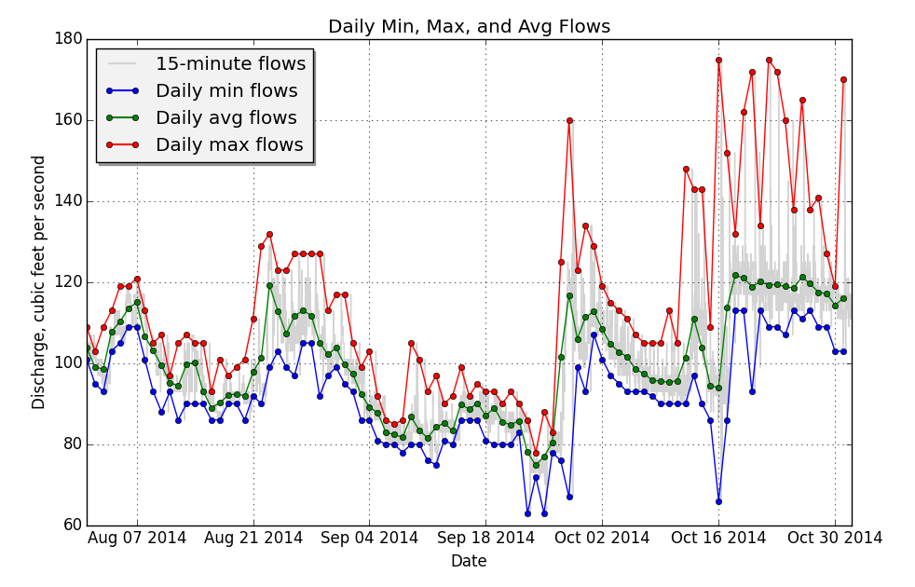
Reproducible Visualization in Python

Slide 14
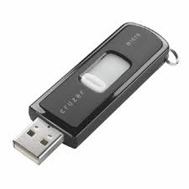

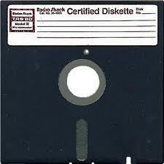
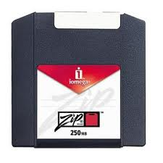
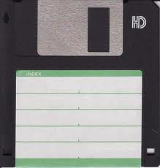
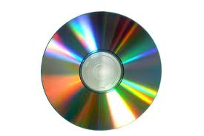
7. Consider Storage Media
2000
CDs?
DVDs?
External hard drives?
Don’t strand your data!!!
1995
1976
1986
1994
1985

Slide 15
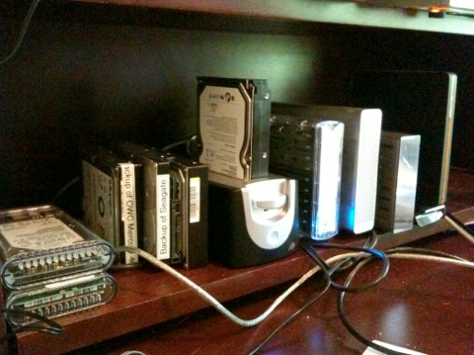
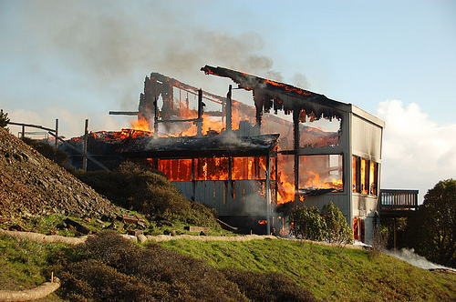
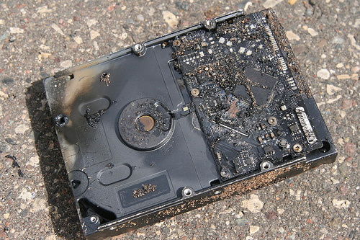
Preservation/Backup Media
How are you preserving your data now?
Does Your Office Look Like This?
What are the potential problems?
What are some potential solutions?

Slide 16
Backups
Have a plan
Stick to your plan
Test your plan – preferably under non-failure conditions!
Don’t trust/rely on hardware redundancy

Slide 17
Plan to Preserve
What will be preserved?
Where will it be preserved?
Back ups?
Version control?
Policies for access, sharing, and reuse
Obligations for sharing
Security and access control
Sensitive data
How long?
Intellectual property issues
Responsible parties

Slide 18


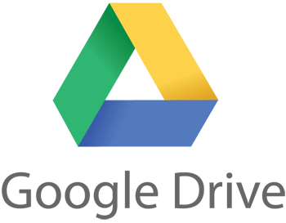
To the Cloud!
Convenience
Accessibility anywhere
Cross platform
Enhanced sharing
Low cost
But…
Privacy???????
Delay (slow or non-existent internet)
Storage, but not much else
File formats and semantics still matter
Disclaimer: Use of these logos is not authorized by, sponsored by, or associated with Microsoft, Google, or Dropbox.

Slide 19

USU Box Service http://box.usu.edu
Upload and share files
Sync to your computer
Collaborate using shared documents
Automatic revision control
Faculty and staff get UNLIMITED GB, students get 50 GB (which you can keep when you leave USU)
Secure for sensitive data
More info: http://it.usu.edu/box/

Slide 20









New Opportunities for Data Sharing and Preservation
Emerging data archives/repositories
Functionality for collaboration and archival/preservation
Still very much discipline specific
Impact is higher if you choose carefully!
CUAHSI
HIS
Sharing hydrologic data
Notes:
USU Digital Commons

Slide 21
8. Maintain Metadata
Borer et al.: “Do not underestimate your ability to forget details about a study!”
When did the tree that was stuck in my stream cross section get removed????
You may not analyze your data until years down the road
Exact details of methods, names, files, etc. will become fuzzy

Slide 22
What is Metadata?
Metadata is “Information about Data”
WHO created the data?
WHAT is the content of the data?
WHEN were the data created?
WHERE is it geographically?
WHY were the data developed?
HOW were the data developed?
Content, quality, condition, and other characteristics
Notes:
Greek --- with, about, between, or among; typically used as prefix to mean “one level of description higher”

Slide 23
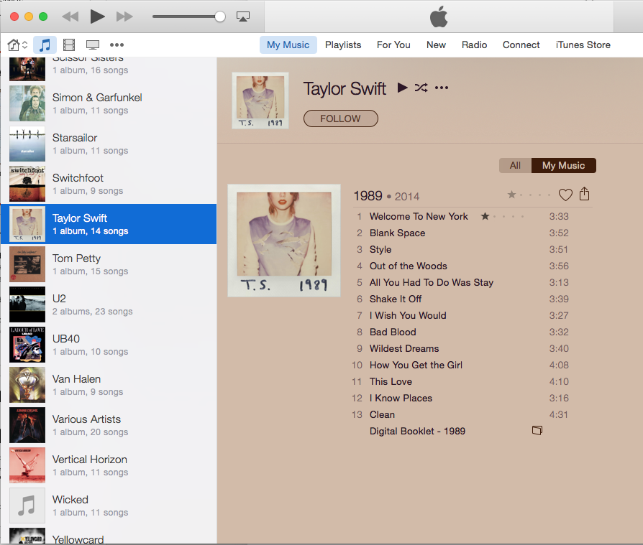
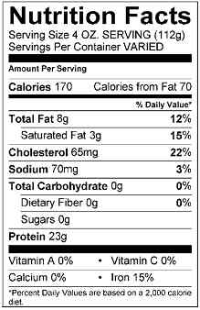
Metadata is All Around
CC image by USDAgov on Flickr
Details about the songs in your MP3 library.
Details about the cereal you ate for breakfast this morning.

Slide 24
Metadata Content and Format
What metadata are needed?
Details that make data meaningful
How will metadata be created?
Lab notebooks?
Automatically generated by a sensor or instrument?
What format will be used for the metadata?
Standards may be chosen by community or dictated by an agency

Slide 25
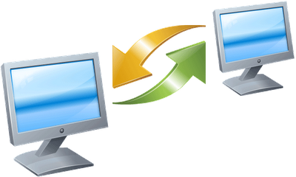
Sharing Data: The Golden Rule
When you provide data to someone else, what types of information would you want to include with the data?
When you receive a dataset from an external source, what types of details do you want to know about the data?

Slide 26
Sharing Data
Providing data:
Why were the data created?
What limitations do the data have?
What does the data mean?
How should the data be cited if it is re-used in a new study?
Receiving data:
What are the data gaps?
What processes were used for creating the data?
Are there any fees associated with the data?
In what scale were the data created?
What do the values in the tables mean?
What software do I need in order to read the data?
What projection are the data in?
Can I give these data to someone else?

Slide 27
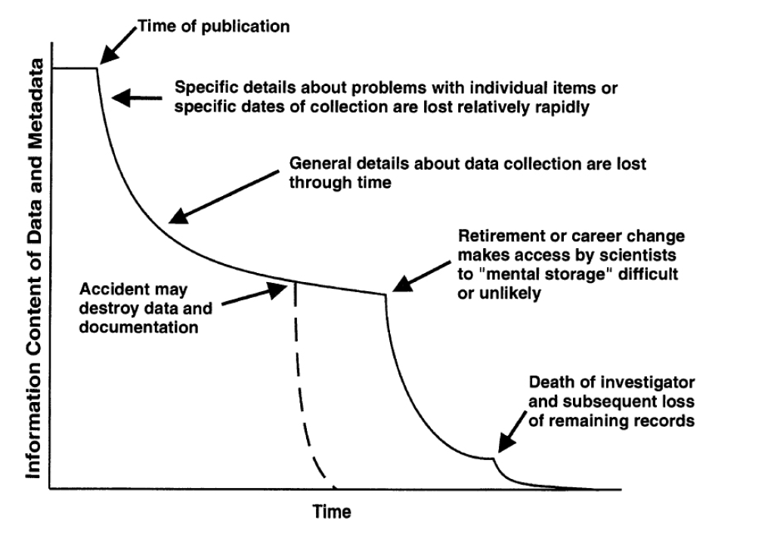
Information Entropy
Example of the normal degradation in information content associated with data and metadata over time (“information entropy”). (Figure taken from Michener, 2006).
Notes:
Add slide about reversing info entropy

Slide 28
Information Entropy
“Do not underestimate your ability to forget details about a study!”
Borer, E.T., Seabloom, E.W., Jones, M.B., Schildhauer, M. (2009). Some simple guidelines for effective data management. Bulletin of the Ecological Society of America 90:205-214. dx.doi.org/10.1890/0012-9623-90.2.205
“If the information on an observation is lost, it is lost forever because it is almost impossible to measure the observation again in the original context.”
Specht, A., Guru, S., Houghton, L., Keniger, L., Driver, P., Ritchie, E.G., Lai, K., Treloar, A. (2015). Data management challenges in analysis and synthesis in the ecosystem sciences. Science of the Total Environment. Dx.doi.org/10.1016/j.scitotenv.2015.03.092
If the rewards of the data deluge are to be reaped, then researchers who produce those data must share them, and do so in such a way that the data are interpretable and reusable by others.
Borgman, C.L. (2012). The conundrum of sharing research data. Journal of the American Society for Information Science and Technology 63(6): 1059-1078. dx.doi.org/10.1002/asi.22634

Slide 29
What if instead?
Data synthesized and leads to another publication
Paper using data is published
Information Content of Data and Metadata
Data annotated by additional users
Curated data published in a data repository
Time
Notes:
Our goal for data management for iUTAH is to reverse this process and actually INCREASE the information content of data.

Slide 30
Federal Agency’s“Open Data”
Public: subject to restrictions of privacy, confidentiality, security
Accessible: convenient, non-proprietary, retrieved, indexed, searched.
Described: robust, granular metadata
Reusable: no restrictions on use
Complete: primary data
Timely: as quickly as necessary
Managed Post-Release: contact to assist

Slide 31
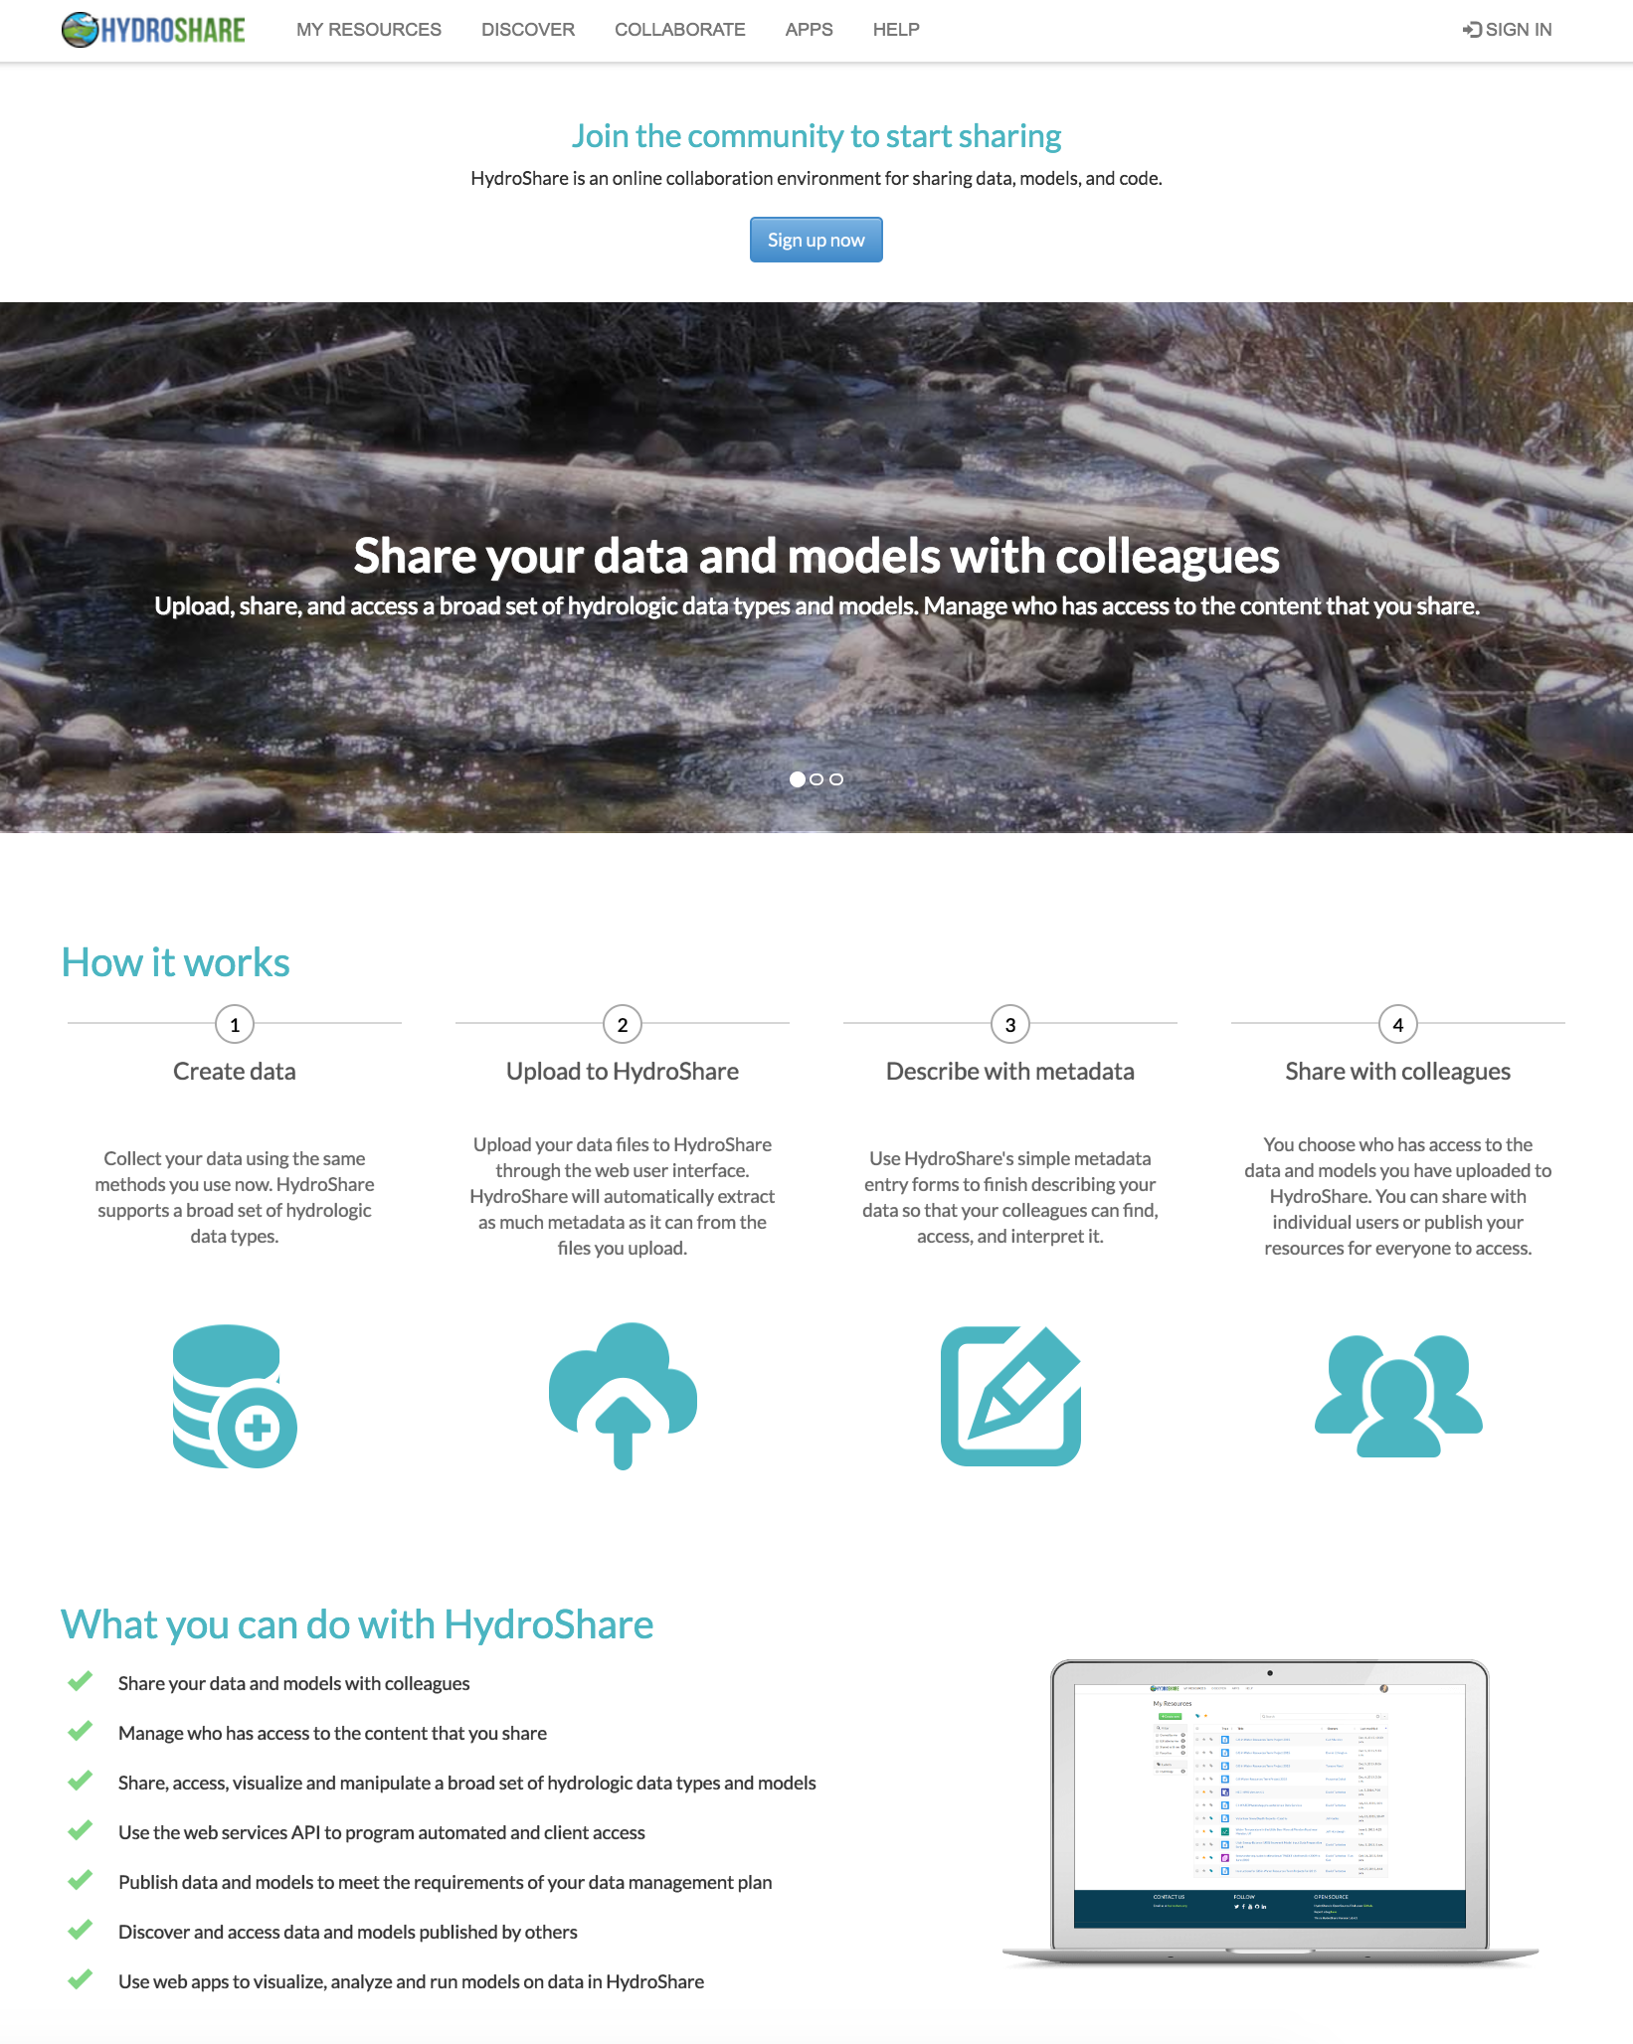
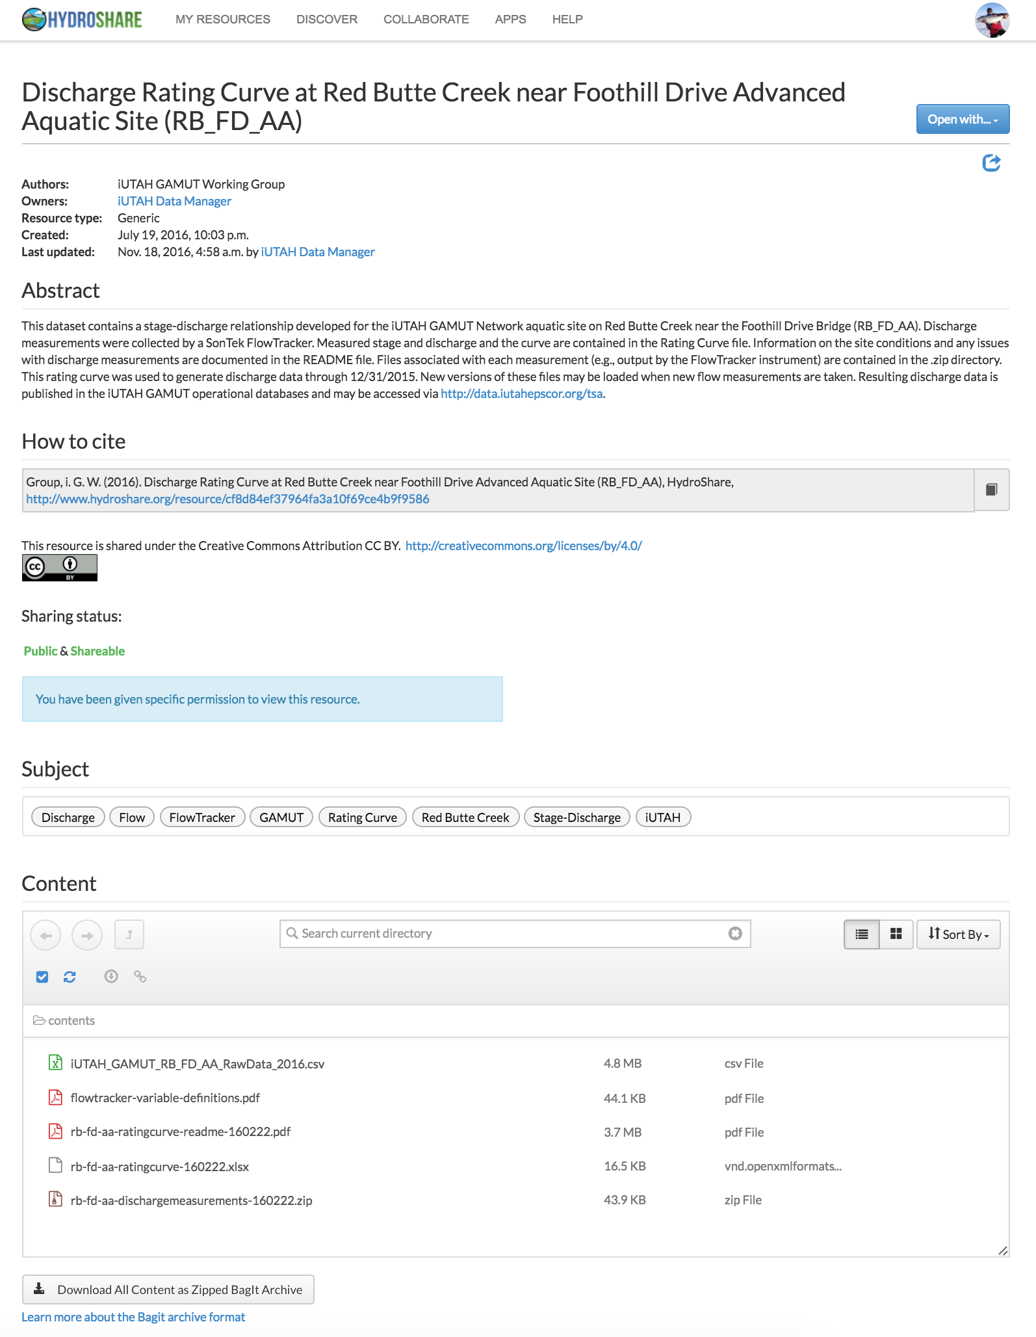
http://www.hydroshare.org
An online, collaborative system for sharing and publishing a broad set of data types, models, and code
Under development by the hydrologic community
Flexible data model accepts any file type- can accommodate social science datasets alongside biophysical data
Consistent general level metadata with extensibility to include additional metadata elements specific to a data type (e.g., alterations to secondary data)
Support for collaboration- sharing with individuals, groups, or publically
Ability to formally publish with a DOI

Slide 32
Repository Challenges
Define practices for data reuse (licenses, citations)
Protect data from misinterpretation
Size limitations for individual users
Level of required metadata – where to set the bar?
Dataset review
Ongoing curation

Slide 33
Repository Challenges

Slide 34
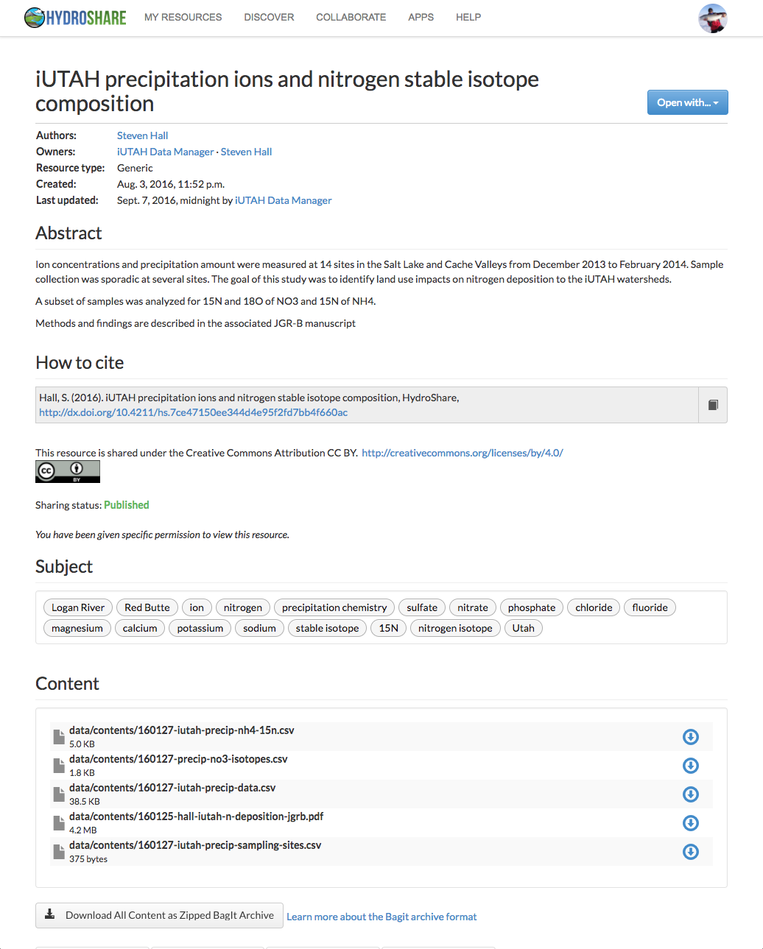
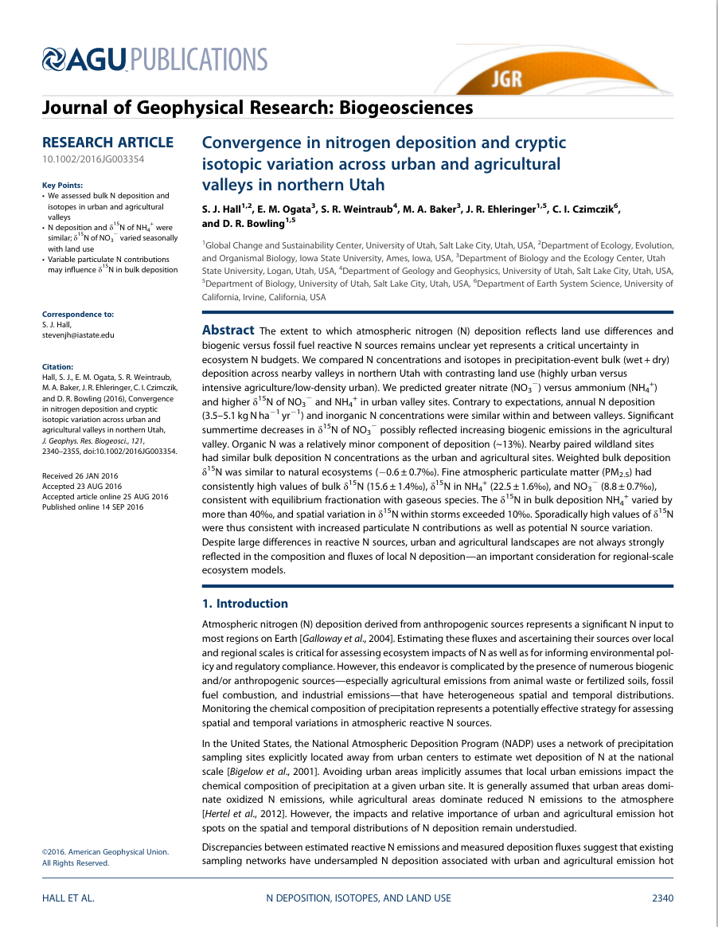





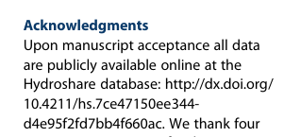
The Steven Hall Story
Steven verified his data and metadata were correct but kept the data private
Steven submitted his paper for publication and responded to reviews
With a little help, Steven deposited his dataset in the online HydroShare repository
Steven published his data in HydroShare and received a DOI
Steven collected his data in the field and transformed into a sharable format
Steven published his paper and cited published data in HydroShare

Slide 35
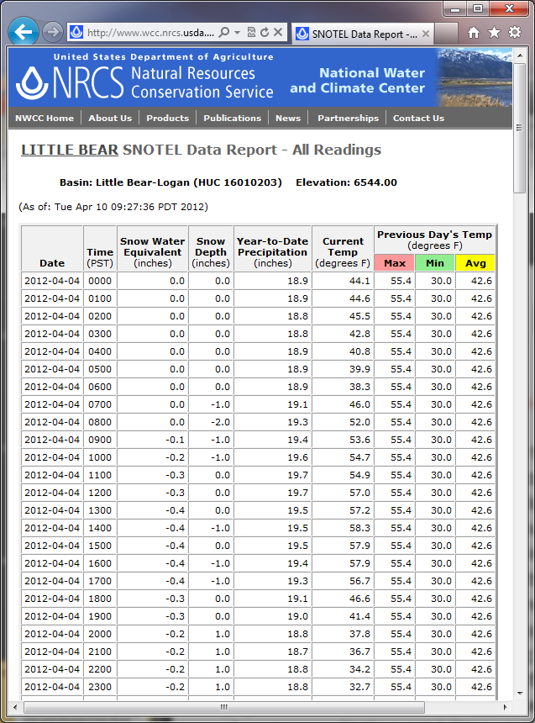
Data Use Case – NRCS SNOTEL
Notes:
Jeff – relay story…

Slide 36
Data Use Case – NRCS SNOTEL
“I am trying to obtain a record of hourly precipitation. Your sites have data for precipitation accumulation, but I cannot use that to back calculate precipitation for each hour because there are frequently losses in precipitation. For example, the accumulated precipitation might go from 7.5 to 7.4 to 7.3 and then increase again to 7.5. Can you offer any advice on obtaining the incremental rather than accumulated precipitation?”
Notes:
Jeff – relay story…

Slide 37
An Interesting Response from NRCS
“The short answer to your question is: don't use it. its all crap. The long answer is: the sensor used to detect precipitation and snow water equivalent is a pressure transducer modified from reading pressures of up to 2000 psi down to reading pressures of 0 to 5 psi and does not have the necessary stability in either accuracy or precision to measure hourly values of 0.1 inches especially within the environment of its setting with varying temperatures, barometric pressure, expansion and contraction of the precip gage itself, frost heave and the list goes on. These data on an hourly incremental basis are not stable. On a daily basis measured from midnight to midnight are sufficiently accurate for our purposes of water supply forecasting and hydrologic modeling - but even then can be plus/minus 0.5 inches at some of the more variable sites. As the time increment increases, the accuracy of the gage increases as well. daily values are decent, weekly more so and monthly pretty close as we edit the variability out. Hourly are crap.
Bottom line - don't use hourly pcp data for anything other than amusement or instructional value of knowing/teaching what your data are, how they are collected and what they represent.”
Notes:
Jeff – relay story…

Slide 38
Summary
Don’t mess with the raw data
Use descriptive file names
Use descriptive file headers
Archive data in non-proprietary data formats
Consider data entry
Automate analyses
Consider storage media
Maintain metadata
Following these steps help prepare datasets for deposit and sharing in a repository
Notes:
Revise this slide

Slide 39
References
Borer, E.T., E.W. Seabloom, M.B. Jones, and M. Schildhauer (2009). Some simple guidelines for effective data management, ESA Bulletin, 90(2):205-214, http://dx.doi.org/10.1890/0012-9623-90.2.205
Borgman, C.L. (2012). The conundrum of sharing research data. Journal of the American Society for Information Science and Technology 63(6): 1059-1078. dx.doi.org/10.1002/asi.22634
Brewer, P (2017). ”Do you expect me to just give away my data?”, EOS, https://eos.org/editors-vox/do-you-expect-me-to-just-give-away-my-data
Michener, W.K. (2006). Meta-information concepts for ecological data management, Ecological Informatics, 1(1), 3-7, http://dx.doi.org/10.1016/j.ecoinf.2005.08.004.
Specht, A., Guru, S., Houghton, L., Keniger, L., Driver, P., Ritchie, E.G., Lai, K., Treloar, A. (2015). Data management challenges in analysis and synthesis in the ecosystem sciences. Science of the Total Environment. dx.doi.org/10.1016/j.scitotenv.2015.03.092
White, E.P, Baldridge, E., Brym, Z.T., Locey, K.J., McGlinn, D.J., and S.R. Supp (2013). Nine simple ways to make it easier to (re)use your data, PeerJ PrePrints, http://dx.doi.org/10.7287/peerj.preprints.7v2

